Slide 1
Mindmup on Vue

Slide 2
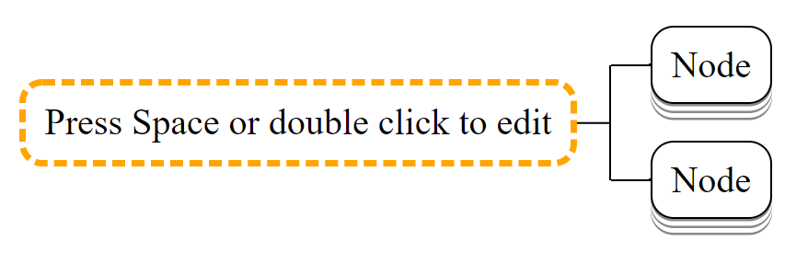
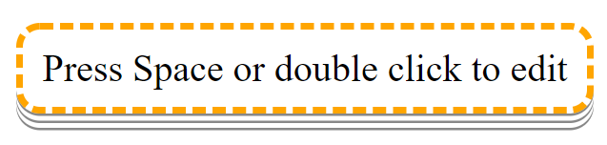
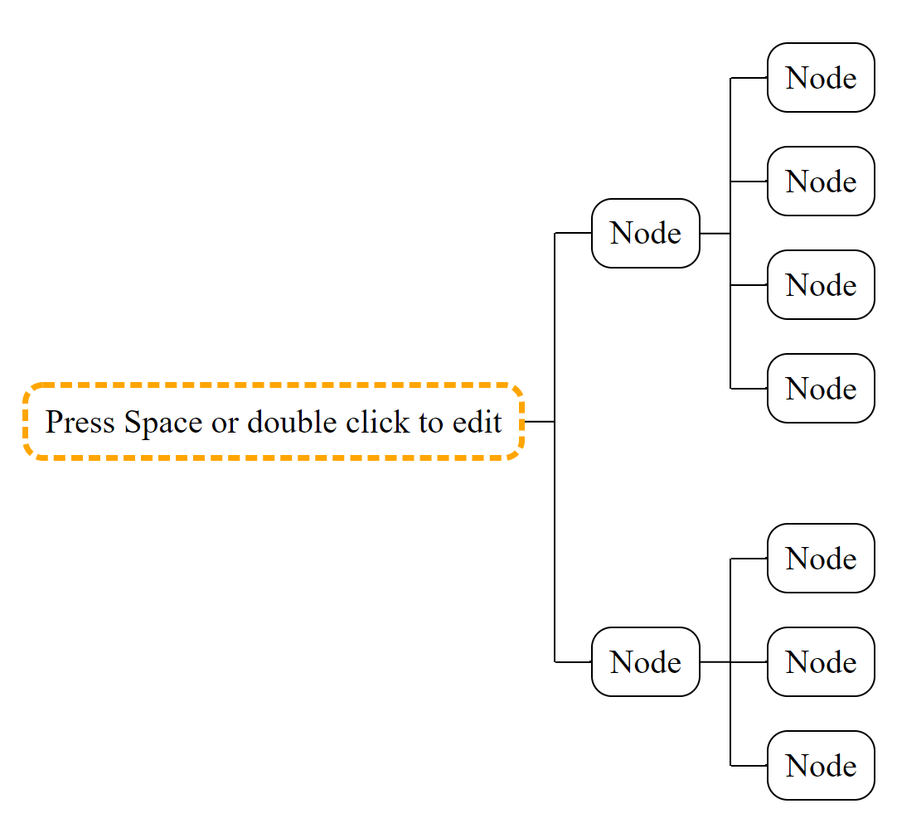
Remap the expand/collapse key from F to D...
Collapse child nodes:
Collapse node:
Expand:

